Slide 1
GeoCoder Project and TriMet
Thoughts on what we're going to need,
both short-term development
and long-term support
November 2016

Slide 2
Pelias: help needed
consultants to show Frank Purcell and Grant Humpheries how to run the ETL tools
consultants (on-site and electronic availability) from MapZen to work with John Zimmerman (JZ) to install Pelias and all related ETL tools in his server environment
consultants to set up a support mechanism between Myleen Richardson & Madeline Steele, and respond to their ongoing questions & feedback when they encounter end-user issues with the geocoder

Slide 3
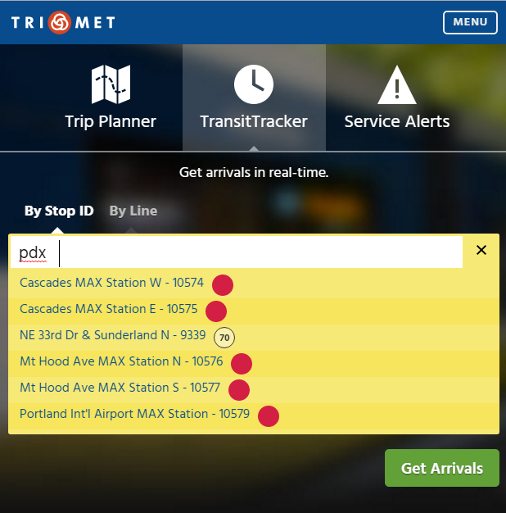
trimet.org
Things to look at:
SOLR on TransitTracker tab
Stops Only query
Route data in SOLR response

Slide 4
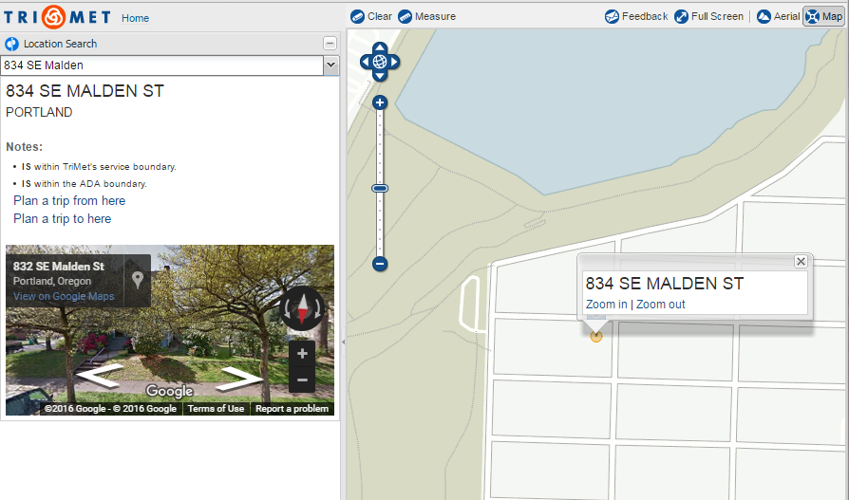
mobilitymap.trimet.org / SOLR
Things to look at:
In addition to LIFT, the DOR uses the map to determine if a business is in/out of the TriMet district, for tax purposes.
This same in/out of TriMet info from the geocoder appears on a public district / tax page on trimet.org for the general public.

Slide 5
Pelias: help needed
consultants to show Frank Purcell and Grant Humpheries how to run the ETL tools
consultants (on-site and electronic availability) from MapZen to work with John Zimmerman (JZ) to install Pelias and all related ETL tools in his server environment
consultants to set up a support mechanism between Myleen Richardson & Madeline Steele, and respond to their ongoing questions & feedback when they encounter end-user issues with the geocoder

Slide 6
Pelias: Potential Challenges
The ATIS geocoder took 10 years to stabilize as a platform.
Myleen & Madeline (M&M) are going to take the brunt of this project …
Project Success (measured as zero customer complaints) will require a feedback -> fix -> deploy loop involving M&M, MapZen and (to a lesser extent) JZ
I believe Pelias will have issues with things like ZERO-leading address points … they’ll be other issues

Slide 7
Pelias: Other Thoughts
there is nothing Zen about the Pelias repo https://github.com/pelias
there are projects with javascript, Node.js, Ruby, vagrant, chef, docker, sqlite3 geo, Elasticsearch is a daunting hodgepodge of many different technologies needed to getting Pelias up and running)
don’t agree with Diana when she says, “we’ve already got a geocoder” … no we do not have a geocoder until we can retire both SOLR and ATIS

